Slide 1
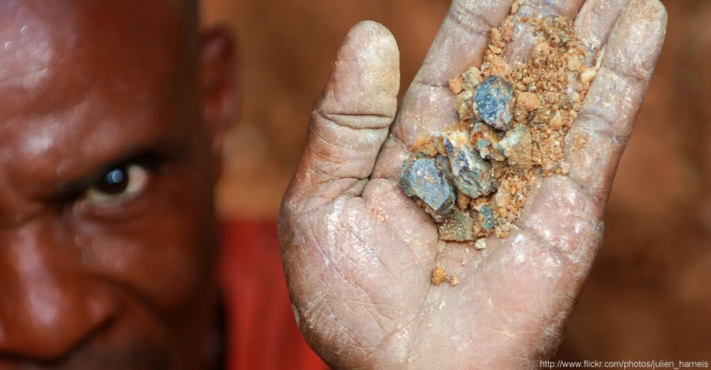
Conflict Minerals in the Democratic Republic of Congo:
Raise Hope for Congo.
Annie Conzemius
Saige Baker-Lietz
Tannica Jacobson

Slide 2
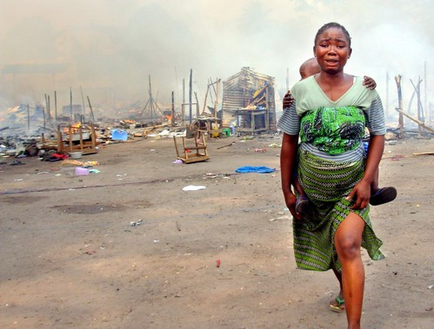
The Democratic Republic of Congo
The Conflict in the DRC has been deemed the worst genocide in Africa.
Every day, thousands of woman and girls are raped by Rebel militia groups as a weapon to control Congo’s precious mines.
The Conflict has already claimed the lives of over 5 million civilians and forced some 3.4 million to flee their homes.
The DRC is estimated to have a mortality rate of 45 thousand per month.
Hundreds of thousands are displaced each day.
It is the deadliest conflict our world has faced since WWII

Slide 3

Conflict Background:
Origins of the Conflict are rooted in the 30 years of Mobutu rule and instability since DRC’s independence from Belgium.
1970s and 1980s, the Congo (then Zaire) splintered into various city states, collapsing communication systems and crippling the formal justice system
1996 – Rwanda’s post-genocide Tutsi government invaded the DRC in pursuit of Hutu militia who had fled there. Rwandan backed Congolese rebels expel Mobutu from office and install Laurent Kabila
1997 – Rebellion between Kabila and Rwanda begins. The country becomes a battleground. The rebellion ends in 2003
Rebel groups continue to remain active in the four eastern provinces: South Kivu, North Kivu, Ituri, and Maniema.
2006 – First free elections in the country. Joseph Kabila becomes president but fails to deliver international expectations of peace.

Slide 4
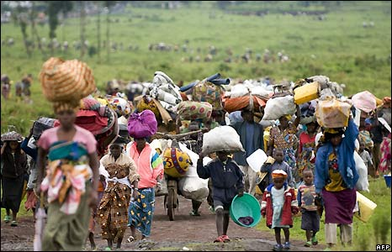
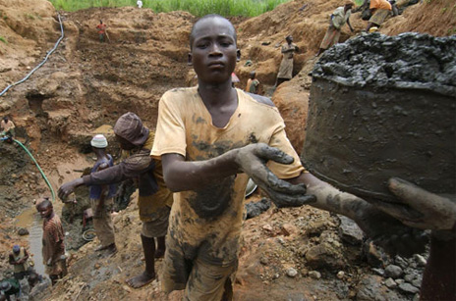
Conflict Profile:
Major driver of the continued violence is Minerals – Tin, Tantalum, Tungsten, and Gold.
This cycle of violence has enveloped the DRC since 1997
It has presented opportunities for various armed groups, both state and non-state, to plunder natural resources by creating and maintaining an environment of exploitation, instability, horror, and appalling inequality.
Militia groups and the state fight for control and access to mines. Armed groups in the area made an estimated total of $185 million in 2008 from the mines.
Congolese Civilians, many of them children, are forced to work the mines at gunpoint and forfeit any of their findings to the armed forces in control
Rape and torture of woman are a common weapon used to enforce labor and cooperation in the mines and surrounding towns.

Slide 5

Key Players:
Congolese Tutsi with Governments of Burundi, Rwanda, and Uganda, relied on the Rwandan Military presence in the DRC (FAC) for protection against Hostile armed groups operating in the Eastern part of the country. These Groups Include:
Interahamwe militia of Ethnic Hutus (mostly from Rwanda who fought the Tutsi dominates Government of Rwanda)
Hutu Members of the Former Rwandan Armed Forces, believed to be responsible for the 1994 Genocide of Tutsis in Rwanda.
The Mai Mai, loose association of traditional Congolese local defense forces which fourth the influx of Rwandan immigrants
The Alliance of Democratic Forces (ADF) made of Ugandan expatriates and supported by the Government of Sudan which fought the Government of Uganda
Several Groups of Hutus from Burundi fighting the Tutsi-dominated Government of Burundi.
The Congolese National Army or the Forces Armées de la République Démocratique du Congo (FDRC)

Slide 6
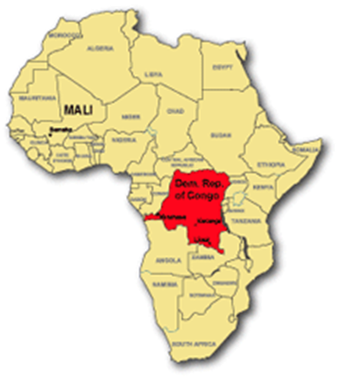

Slide 7
The Minerals:
Tin(Cassiterite Ore)- Leading mineral in terms of dollar value contributing to armed groups in the DRC. DRC is the 6th largest producer of tin. Half of tin mined is used in soldering electronics. Contributes about $115 million to armed groups in 2008.
Tantalum(Coltan)- DRC is one of the leading producers of this mineral (Coltan). It became the first Conflict medal from the DRC to become the subject of Global Concern when the price for the mineral spiked in conjunction with growing demand from the electronics industry. Used in automotive electronics, cell phones, computers, super alloys. $12 Million to armed groups in 2008.
Tungsten(Wolframite)- DRC is the world’s 5th largest producer of this mineral. Least noticeable in consumer materials because it’s used in steel cutting tools and other components used in a large number of different electronic supply chains. Contributed about $7.4 million to armed groups in 2008.
Gold- smallest conflict mineral by volume but second only to tin in its contribution to armed groups. Estimated at about $50 million to armed groups in 2008. Gold’s high value low volume nature makes it easy to conceal and transport. 95% of the Eastern DRC’s Gold is traded informally. It’s very difficult to track because it van be smuggled so easily. Nearly 80% of gold produced globally is used to make jewelry but it is also used in electronics, medical equipment, and aerospace.

Slide 8
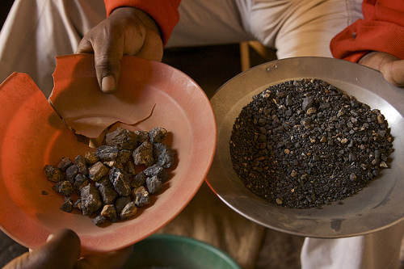
The Seven Steps of the Supply Chain
Mines- 13 major mines, 200 total mines in the region (eastern Congo). 12 of the 13 major mines are controlled by the armed groups. Estimated that armed groups and military control over 50% of the 200 of the total mines.
Trading Houses- Minerals are transported to trading towns and then onto the two major cities in the region- Bukavu and Goma. The three T’s are brought by individuals on their backs, by large trucks, and/or planes. The minerals are then sorted at trading houses.
Exporters- export companies buy minerals from the trading houses and transporters, process the minerals using machinery and then sell them to foreign buyers. There are 17 exporters based in Bukavu and 24 based in Goma.
Transit Countries- (Rwanda, Uganda, Burundi…) – from the exporters the minerals are sent to the neighboring countries of Rwanda, Uganda, and Burundi.
Refiners- Metal processing companies based mainly in east Asia take the Congolese minerals and smelt or chemically process them together with metals from other countries in large furnaces.
Electronic Companies- The refiners sell Congo’s minerals unto the electronic companies. (Samsung, Apple, Nokia, Nintendo, Canon, Intel….)
YOU (Consumers)

Slide 9
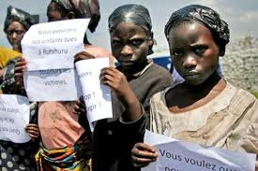



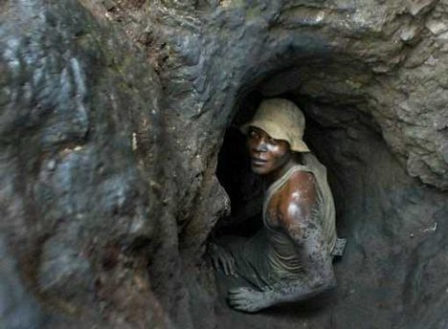
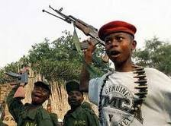
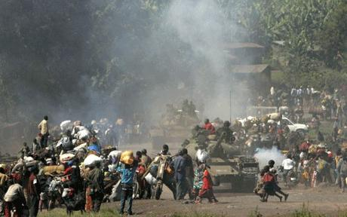

Testimonies:
http://www.youtube.com/watch?v=izTzCv4480k
http://www.youtube.com/watch?v=h7-56NHS_iE
http://www.youtube.com/watch?v=XIoJrrKixBM
http://www.youtube.com/watch?v=XgneoKiY-SM

Slide 10
US Legislation: The Dodd-Frank Act
Dodd-Frank Wall Street Reform and Consumer Protection Act
The Act was signed into law 21 July 2010
The Act amends section 13 of the Securities Exchange Act of 1934.
    The amendment requires companies reporting to the SEC to file periodic reports disclosing their use of “conflict minerals”.
    Applies only to SEC reporting companies – companies with more then $10 Million in assets whose securities are held by more than 500 owners.
    Reporting requirements apply to each SEC reporting company that uses “conflict minerals” in the production or functionality of any product manufactured by it.
If such “Conflict Minerals” did originate from the DRC or adjoining country, then SEC reporting companies have to submit to the SEC a report that includes:
    A description of the measures taken by the reporting company to exercise due diligence on the source and chain of custody of the “conflict minerals”
    A description of the products (whether manufactured by the Reporting Company or manufactured for it by a contractor) that contain “conflict minerals” originating from the DRC or adjoining country.
    The name of the entity that conducted the audit described below;
    A description of the facilities used to process the :conflict minerals
    The country of origin of the “conflict minerals”; and
    A description of the efforts employed by the Reporting Company to determine the mine or location of origin of the “conflict minerals” with the greatest possible specificity.

Slide 11
Retailers Complaints and Concerns:
Companies such as Target Corp., Wal-Mart, and Best Buy, which carry private-label goods (companies who get their goods made by a contract manufacturer under its own label) argue they should not have to comply because they do not exercise direct control over the manufacturing of goods carrying their own brands.
The Retail Industry Leaders Association sent a letter making that case to the Securities and Exchange Commission.
The SEC say they have the power to decide who is considered a manufacturer under the law and who must comply with it.
The RILA argue that tracing the source of the mineral is tricky due to too many intermediaries between them and the mines and the constant flux in control of territory and transit routes in the Eastern Congo.
Many also worry that the requirement may halt all use of minerals from the area, effectively ending the only form of economic activity for hundreds and thousands.
RILA wants to allow the supply chains to continue sourcing, but to do it properly.
This idea is meant with concerns as it could result in a black market, directly subverting the policy intention of the law.

Slide 12
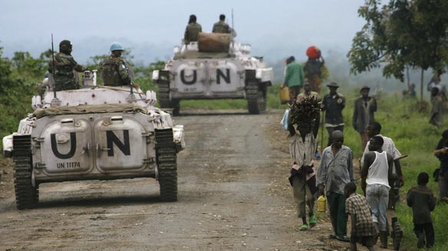
UN Involvement:
United Nations Mission in the DR Congo (MONUC)
The largest and most expensive peacekeeping mission in UN history comprising of about 20,000 personnel on the ground and a 09/10 budget of $1.35 billion.
Human Rights Watch has suggested the UN is risking becoming complicit in atrocities against civilians.
In 2009, a report by UN commissioned exports said that the UN had done nothing to quell the violence.
August 2010, the MONUC was under harsh criticism for doing nothing to prevent the rape of over 200 woman and children within miles of their base, claiming that they only heard of the event 10 days after.
Amnesty International response

Slide 13
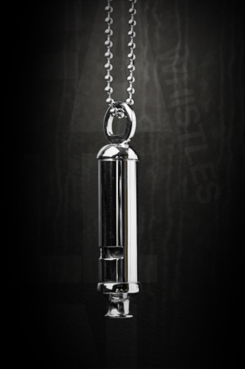


TAKE ACTION
Falling whistles
  Be a whistleblower for peace in Congo
  Proceeds go to rehabilitate and advocate for war-affected
The Enough Project
  Project to end genocide and crimes against humanity
  3P approach: promoting peace, protecting civilians, and punishing perpetrators
Raise Hope for Congo
  Collaborates with the Enough Project
  Advocate for the protection and empowerment of the Congolese people
Go conflict Free and urge your school to do the same!

Slide 14
Resources:
www.enoughproject.org
Behind the Ban: An Update from Eastern Congo. By Fidel Bafilemba
How Gold Pays for Congo’s Deadly War: 60 Minutes: Killing Continues in the Deadliest War Since WWII as Gold and Other Minerals Pay for Weapons
www.insightonconflict.org/dr-congo
Retailers Fight to Escape ‘Conflict Minerals’ Law. Wall Street Journal. By Jessica Holzer
Raise Hope for Congo, The Conflict Free Campus Initiative. An Enough Campaign
US Legislation on Conflict Minerals. RCS Private Sector Guidance on The Dodd-Frank Act Section 1502.
www.globalsecurity.org
http://www.amnestyusa.org/all-countries/congo-dem-rep-of/page.do?id=1011136
Conflict Minerals and the Democratic Republic of Congo. Responsible Action in Supply Chains, Government Engagement, and Capacity Building. www.bsr.org

