Slide 1
L’enquête Nationale
Des Femmes et des Filles Perdues

Slide 2
Question Essentielles
Dans quelle mesure la justice fut atteinte dans l’étude de cas des femmes et des filles Autochtones du Canada ?
Quelles sont les actions current qui arrivent pour combattre l'épidémie des Femmes et des Filles Indigènes Perdues?
Est-ce que les actions sont suffi?

Slide 3
L'enquête Nationale
The Commissioners have a mandate to educate the public, to facilitate healing of traumatized communities, to restore public confidence in institutions that have been seriously damaged in the eyes of Canadians, and to make recommendations for action and policy reform aimed at affecting real changes to make Indigenous women, girls and LGBTQ+ feel safe, sacred, honoured and empowered.
http://www.mmiwg-ffada.ca/en/

Slide 4
L'enquête Nationale
The National Inquiry began operations on September 1, 2016 and has a deadline to complete its work by December 31, 2018. As stated by the Chief Commissioner in an open letter on May 19, 2017 there is a possibility the Commissioners will ask the federal government for an extension.
http://www.mmiwg-ffada.ca/en/

Slide 5
Feuille d’information pour L’enquête Nationale
http://www.mmiwg-ffada.ca/en/resources/information-documents/

Slide 6
Rapport Intermédiaire
“That is what I am looking for— not for my sister-in-law now, because no one can harm her, but that my daughter, my granddaughter, my great-granddaughters can walk the streets in safety, my nieces, that no harm can come to them. We must stand up for justice for these women that have walked before us.”
FRANCES NEUMANN , ON THE MURDER OF HER SISTER - I N - LAW, MARY JOHNS . FROM THE NATIONAL INQUIRY ’ S COMMUNITY HEARING IN WHITEHORSE, MAY 30, 2017.
http://www.mmiwg-ffada.ca/files/ni-mmiwg-interim-report-en.pdf

Slide 7
Rapport Intermédiaire
We need to understand how social structures and laws have so devalued the lives of Indigenous women and girls.
http://www.mmiwg-ffada.ca/files/ni-mmiwg-interim-report-en.pdf

Slide 8
Rapport Intermédiaire
BUT : To bring this vision to life, the National Inquiry has set out on a three-part mission: finding the truth, honouring the truth, and giving life to the truth. This is our path to healing. We will find the truth by gathering many stories from many people. These truths will weave together to show us what violence really looks like for Indigenous women and girls in Canada.
The work of the National Inquiry is not to hear one single truth, but many truths. This will help us understand the far-reaching effects of violence, as well as solutions to end it. We will gather this information through: • Community Hearings, Institutional Hearings, and Expert Hearings; • past and current research; • collaborations with Elders and Knowledge Keepers; and • forensic analysis of police records. We will conduct new research to fill gaps in what we know and to address emerging issues of concern.
http://www.mmiwg-ffada.ca/en/

Slide 9
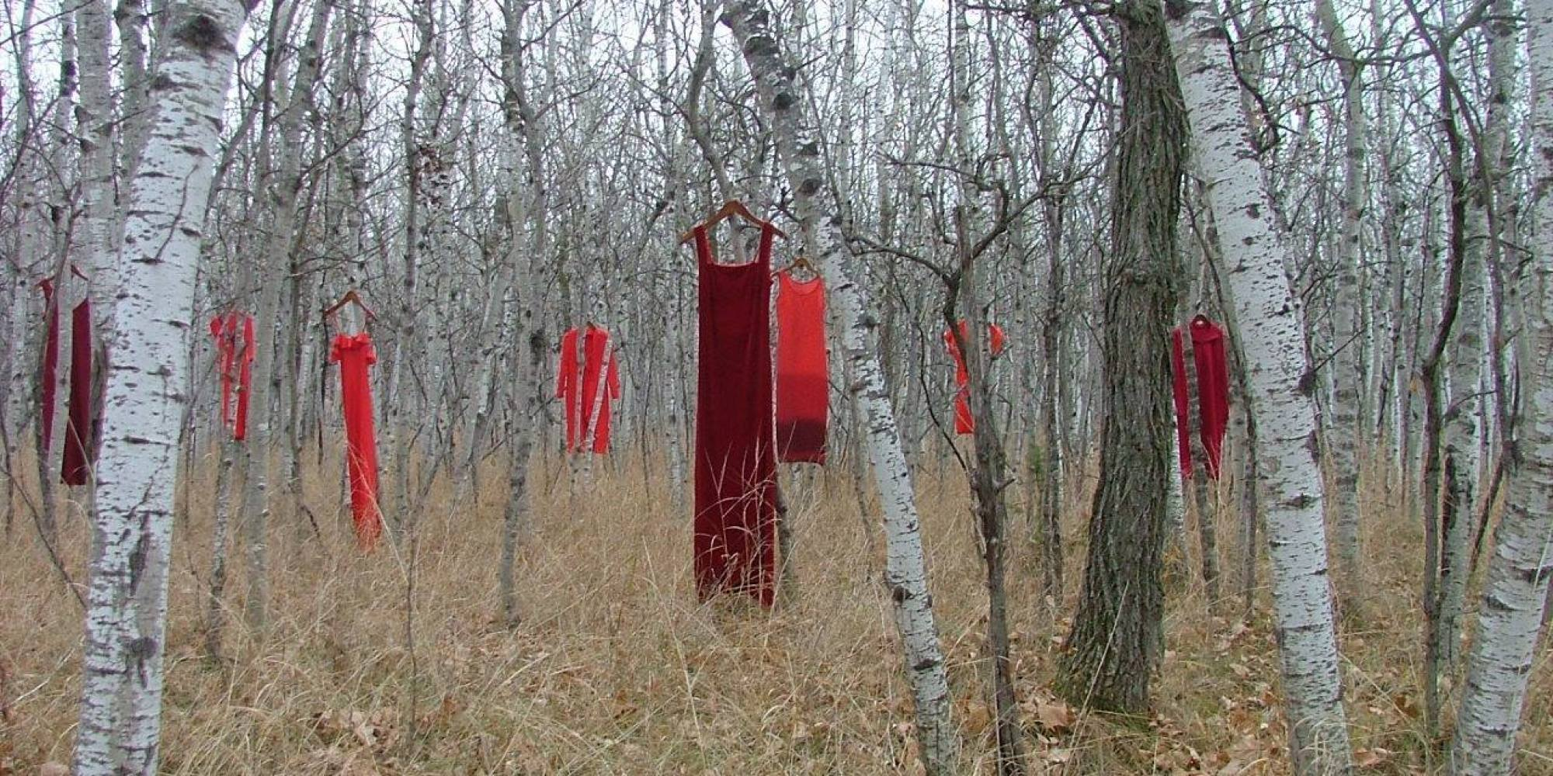
Activisme
http://www.redressproject.org/

Slide 10
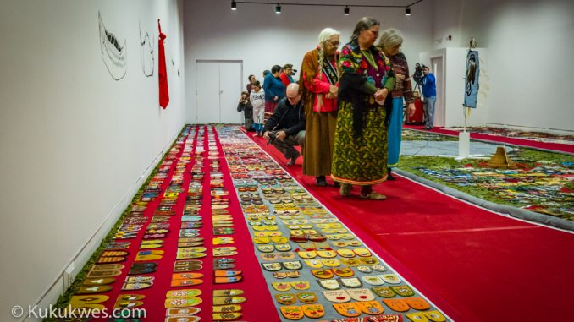
Family members of missing, murdered women contribute moccasin vamps to art exhibit at MSVU
http://kukukwes.com/2017/01/16/family-members-of-missing-murdered-women-contribute-moccasin-vamps-to-art-exhibit-at-msvu/
Lisez l’article et repondez à la question qui suivre.

Slide 11
Qu’est-ce que les claques représentent selon l’article?

Slide 12
L’art des Artistes Indigènes

Slide 13
Analyse En Groupe
Avec vos groupes, analysez l’art qui suivre et répondez aux questions liés.

Slide 14
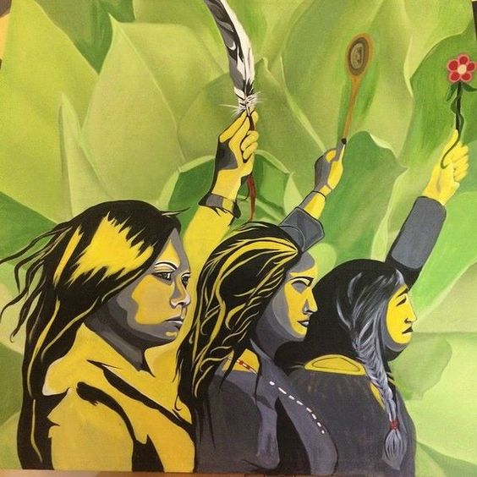
“You Are Not Forgotten” Par: Angela Sterritt

Slide 15
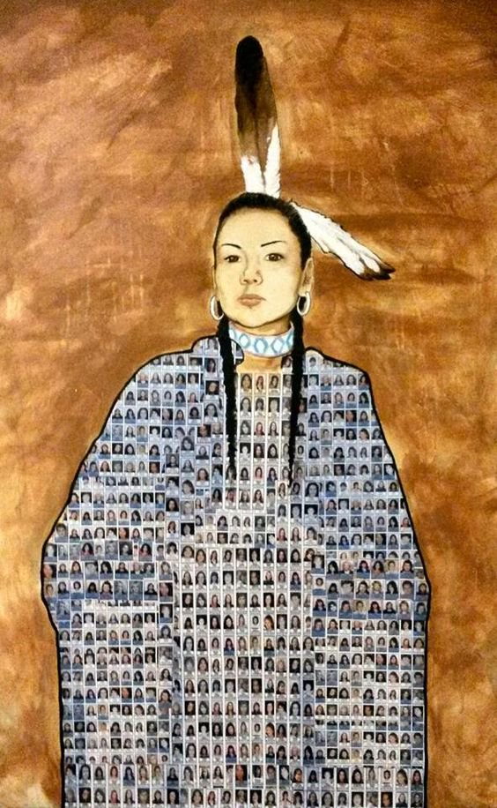
“Still Dancing”Jonathan Labillois

Slide 16
Two Eyed Seeing
Two-Eyed Seeing is the Guiding Principle brought into the Integrative Science co-learning journey by Mi'kmaw Elder Albert Marshall in Fall 2004. Albert is from Eskasoni First Nation and is a highly respected Elder.
Key concepts within this understanding are: co-existence, interrelatedness, interconnectedness, and community spirit. Albert emphasizes that these four apply to our relationships with each other and with Mother Earth.
http://www.integrativescience.ca/People/Elders/#AlbertMarshall

Slide 17
Question
Comment est-ce qu’on peut appliquer ce concept a nos sujets (le Canada qu’on ne voie pas ou les types de justice)?

Slide 18
Two Eyed Seeing
"Two-Eyed Seeing is hard to convey to academics as it does not fit into any particular subject area or discipline. Rather, it is about life: what you do, what kind of responsibilities you have, how you should live while on Earth … i.e., a guiding principle that covers all aspects of our lives: social, economic, environmental, etc. The advantage of Two-Eyed Seeing is that you are always fine tuning your mind into different places at once, you are always looking for another perspective.
http://www.integrativescience.ca/People/Elders/#AlbertMarshall

Slide 19
Two Eyed Seeing
http://www.mikmaweydebert.ca/home/sharing-our-stories/exploring-our-histories/elders-stories/

Slide 20
Ted Talk : Two Eyed Seeing
https://www.youtube.com/watch?v=bA9EwcFbVfg
Qu’est-ce que vous avez entendu lié aux sujets avec lequel nous avons parlé?

