Slide 1
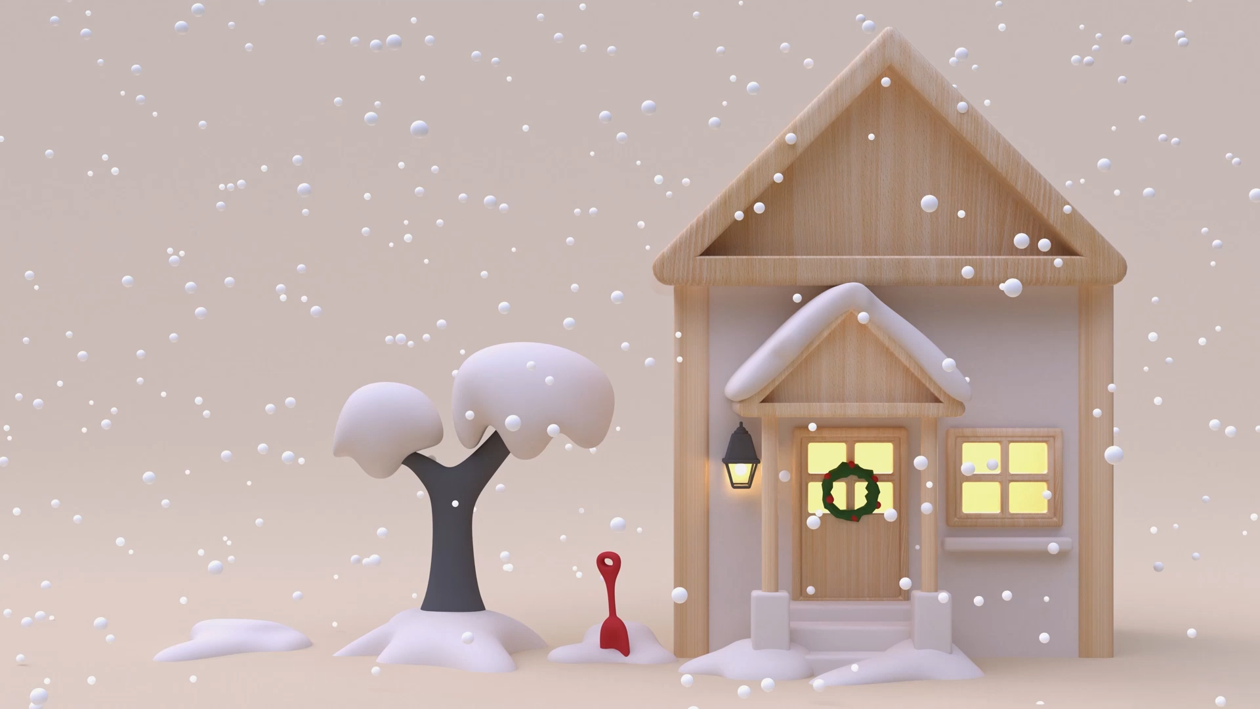
Grammar Practice

Slide 2
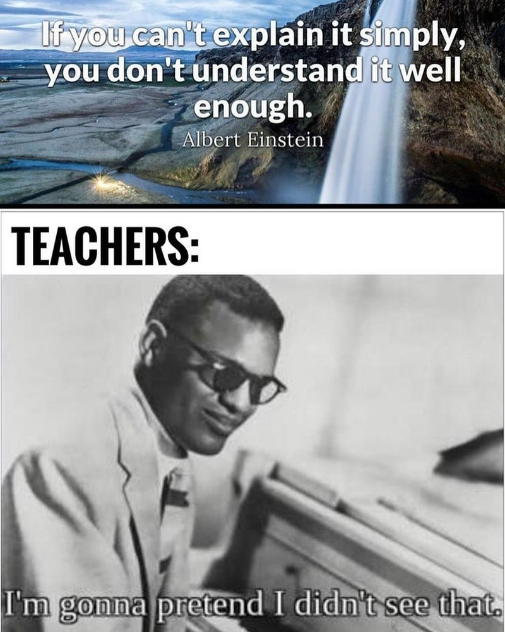
Choose one of the following grammar tenses and teach it to the class

Slide 3
Present ( regular , irregular verbs, avoir, etre , faire idiomatic expressions, negative forms, imperative forms, pronominal verbs, exercises ) Hewson
Passe Compose –Imparfait ( formation, use and application, pronominal verbs, négative, clear distinction in the différence) Cashton
Future Simple, Future Proche ,Passe Proche ( formation, use and application, pronominal verbs, négative, clear distinction in the différence) Layla
Gerund ( formation, use and application, pronominal verbs, negative, clear distinction in the difference) Eduardo
COD,COI ( formation, use and application, pronominal verbs, negative, clear distinction in the difference) Jenna
Les Pronoms et Les Adjectifs ( ch.21-23) Megan
Conditionnel Present CJ

Slide 4
Each Presentation
Explanation: simple, creative, picture enriched, video, podcasts
Exercises A MUST
Follow directions closely
You are to teach for 20-25 minutes plus exercices.
Follow parctice makes it perfect

