Slide 1
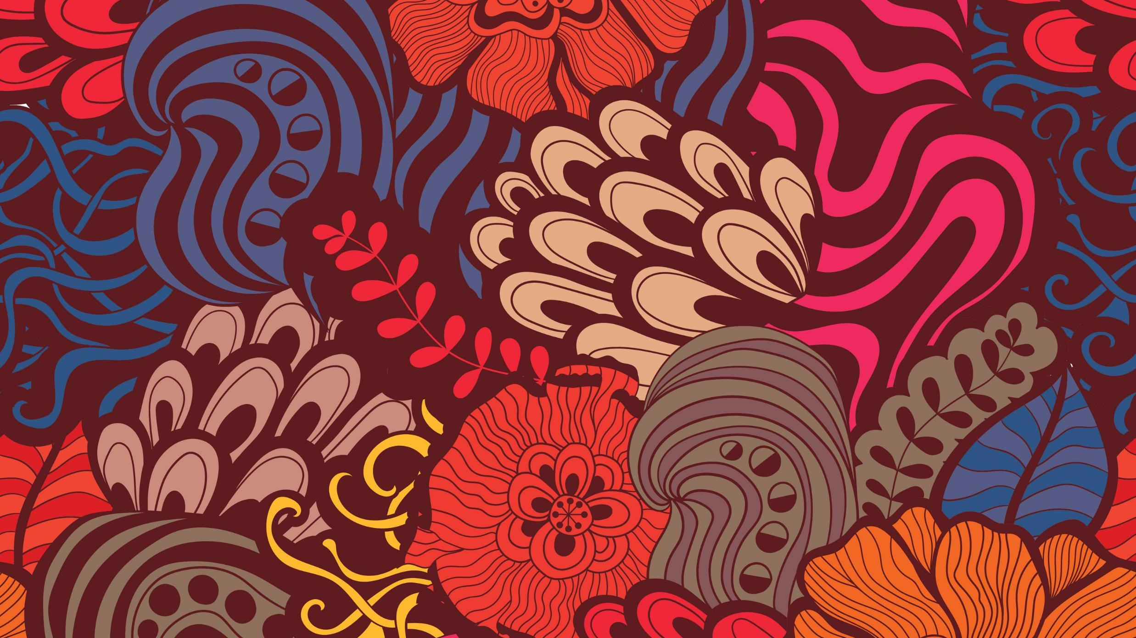
Passé Composé vs Imparfait
Sit Dolor Amet

Slide 2
Point de départ
You have learned the uses of the passé composé versus the imparfait to talk about things and events in the past.
These tenses are distinct and are not used in the same way.
Remember always to keep the context and the message you wish to convey in mind while deciding which tense to use.
Notes:
2

Slide 3
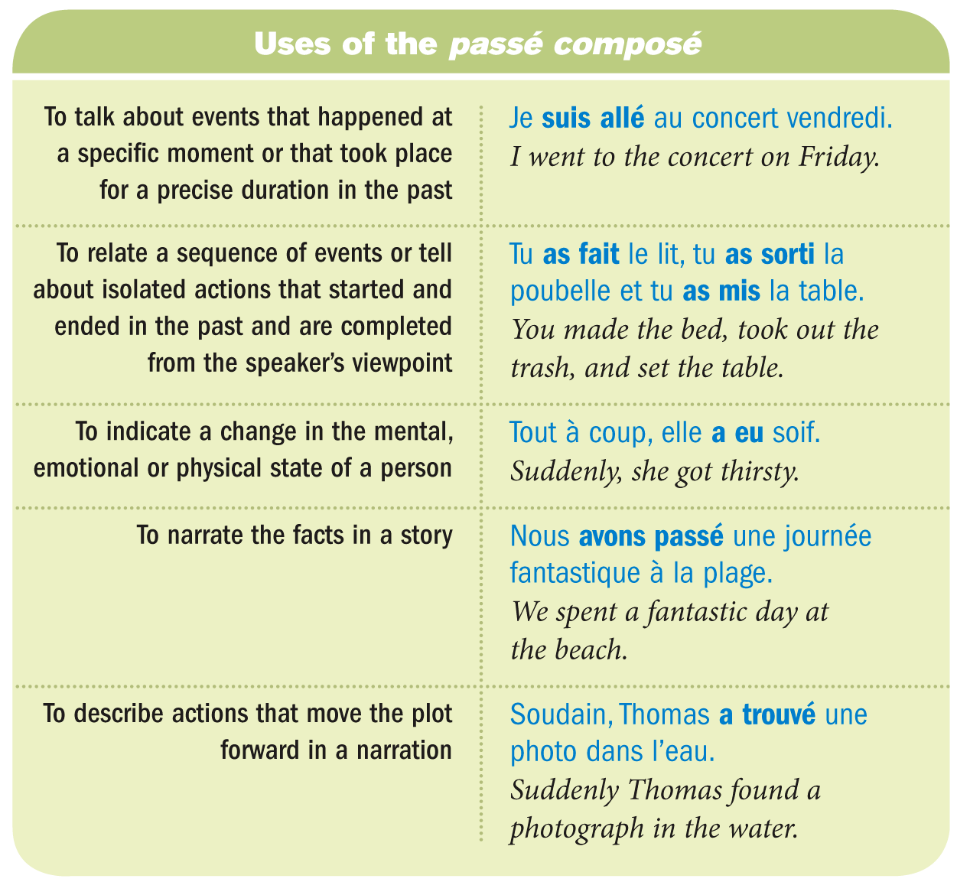
Notes:
3

Slide 4
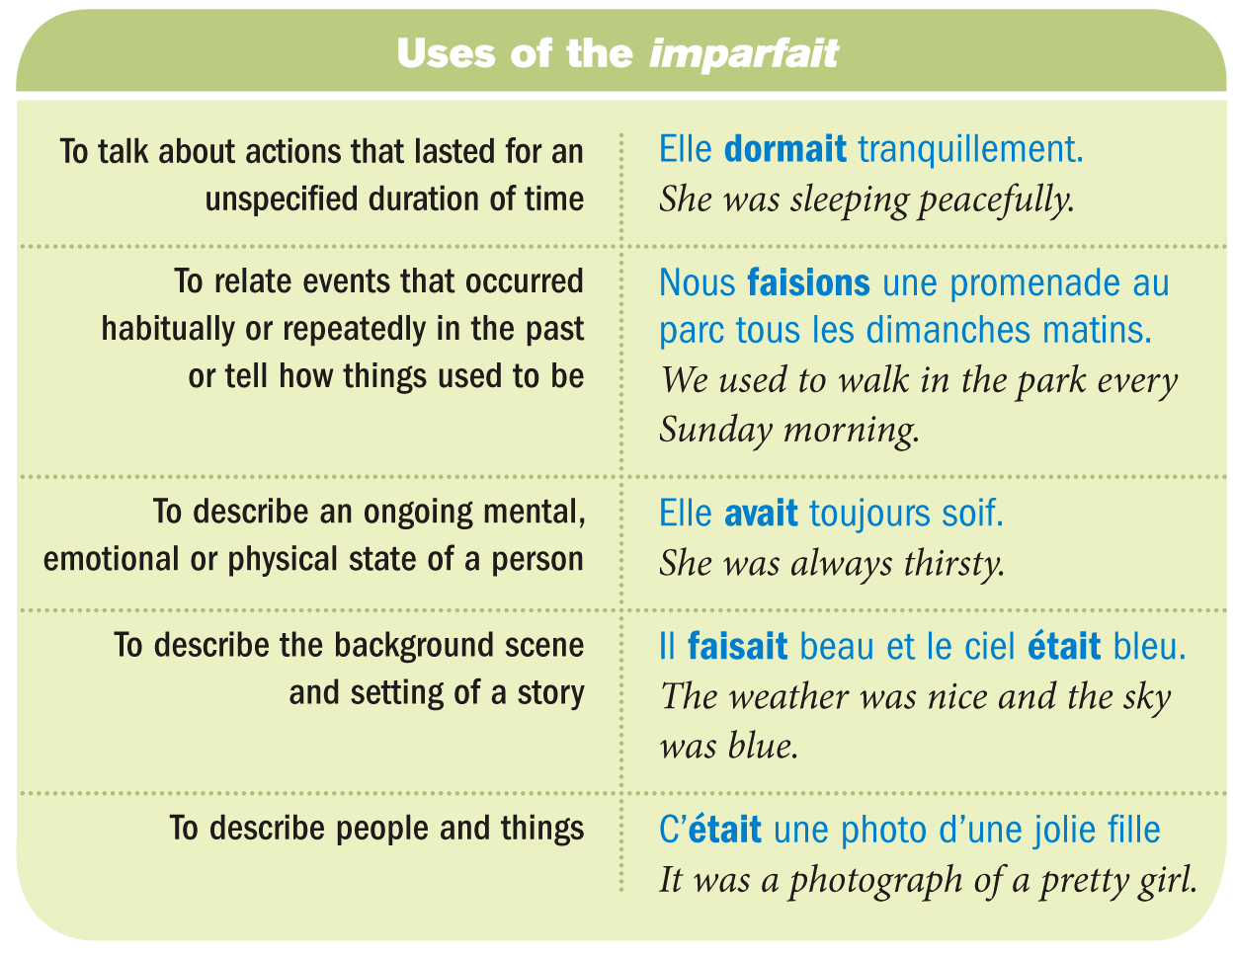
Notes:
4

Slide 5
The imparfait and the passé composé are sometimes used in the same sentence where the former is used to say what was going on when something else happened.
To say what happened that interrupted the ongoing activity, use the passé composé.
Notes:
5

Slide 6
A cause and effect relationship is sometimes expressed by using the passé composé and the imparfait in the same sentence.
Notes:
6

Slide 7
Jacques Prévert: Déjeuner du Matin https://www.youtube.com/watch?v=I4YoBuJCbfo&ab_channel=EmmanuelTenenbaum

Slide 8
The imparfait and the passé composé are sometimes used in the same sentence where the former is used to say what was going on when something else happened. To say what happened that interrupted the ongoing activity, use the passé composé.
Notes:
8

Slide 9
The verb avoir has a different meaning when used in the imparfait versus the passé composé.
Notes:
9

Slide 10
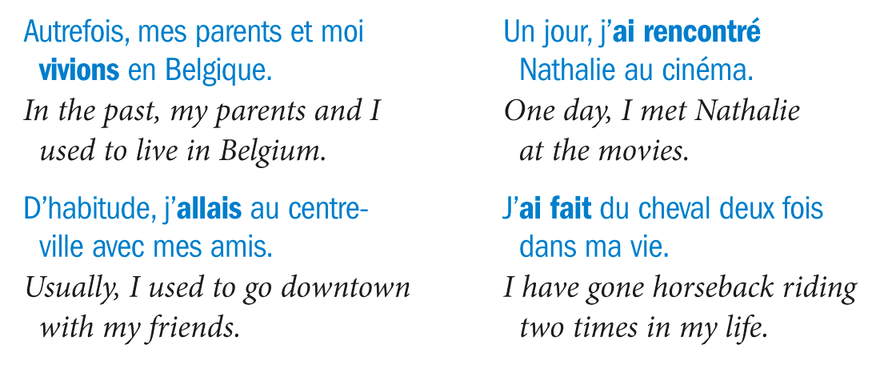
Certain expressions like soudain, tout à coup, autrefois, une fois, d’habitude, souvent, toujours, etc serve as clues to signal a particular past tense.
Notes:
10

Slide 11
Le passé

Slide 12
Le passé composé
actions that have been completed
plot (l’intrigue)
whatever pushes my story forward
what happened in the story (la narration)

Slide 13
Formation:
Verbe auxiliaire (avoir/être) + participe passé
Regular past participles are formed:
er → é, ir →I, re→ u
Irregular past participles see:
http://quizlet.com/10015198/verbes-irreguliers- participe-passe-flash-cards/
Verbes that take être have past participles that agree in number and gender

Slide 14
Verbes that take être (reflexives, too!)
Venir
Devenir
Revenir
Aller Naître Descendre Entrer Rentrer Tomber Retourner Arriver Mourir Partir
Monter Rester Sortir
Passer*

Slide 15
L’imparfait
sets the scene with a description.
Ex. Un jour d'automne, un jeune homme marchait dans la rue. Le ciel était gris et il pleuvait légèrement. Le jeune homme était grand et il portait un gros chapeau. Il marchait lentement. Il était triste.

Slide 16
The imparfait ignores starting points and ending points.
The use of the imparfait tells you:
what was going on or what the scene was like
The use of the imparfait does not tell you:
where he came from
how long he had been walking
how long he would take to get there
whether he will reach his destination and complete his act of walking
* The imparfait is open-ended.

Slide 17
Le jeune homme a glissé sur une peau de banane.
The passé composé narrates a specific, completed event in time. It has a starting point and an ending point.
The use of passé compose tells you:
there is a starting point (the young man unwittingly placed his foot on a banana skin)
which initiated an event (his foot gave way beneath him and his 220-
pound frame came crashing down to the ground)
which then ended (his fall was complete: he ended up lying in a heap on the concrete with an aching backside)

Slide 18
Comparez:
Il a plu hier.
It rained yesterday.
(But then it stopped. By midnight at the latest, the rain was over.)
Il pleuvait hier.
It was raining yesterday.
(We don't know if it stopped or not. It could still be raining today.)
Ce matin, je suis allée au travail.
This morning, I went to work.
(And I made it to my destination. I arrived.)
Ce matin, j'allais au travail...
This morning, I was going to work...
(I was on my way to work. I intended to go to work. (Honest!))

Slide 19
Mots clés (Key words)
Imperfect Passé composé
chaque semaine, mois, année
le week-end
every week, month, year
une semaine, un mois, un an
un week-end
one week, month, year
on the weekends
on Mondays, on Tuesdays...
every day
in the evenings always
one weekend
le lundi, le mardi...
lundi, mardi...
on Monday, on Tuesday
tous les jours le soir toujours
un jour un soir
soudainement
tout à coup, tout d'un
coup
une fois, deux fois...
one day
one evening suddenly
normalement
usually
all of a sudden
d'habitude
usually
once, twice...
en général, généralement
in general, generally
enfin
finally
souvent
parfois, quelquefois
de temps en temps rarement
autrefois
often
sometimes
from time to time rarely
formerly
finalement
plusieurs fois
in the end
several times

Slide 20
Avec un partenaire, terminez l’histoire du monsieur qui a glissé sur la peau de banane utilisant le passé composé et l’imparfait. Décrivez son passé, son caractère et où il est allé après …

Slide 21
Formation
In the passé composé, pronominal verbs are conjugated with être as their auxiliary.
Past participles of pronominal verbs are formed like nonpronominal past participles.
Note that the reflexive pronoun (me, te, se, nous, vous, se) precedes the auxiliary.

Slide 22
s'amuser 'to have fun'
je me suis amusé(e), I had fun nous nous sommes amusé(e)s, we had fun
tu t'es amusé(e), you had fun vous vous êtes amusé(e)(s), you had fun
il / on s'est amusé, he / one had fun ils se sont amusés, they had fun
elle s'est amusée, she had fun elles se sont amusées, they had fun

Slide 23
past participle agreement
It is important to note that, in most cases, the past participle of pronominal verbs agrees in gender and number with the gender and number of the reflexive pronoun, that is, an e is added to the past participle to agree with a feminine subject and an s is added for a plural subject.
Tammy: Je me suis réveillée très tôt ce matin. Tammy: I got up really early this morning.
Tex: Moi, je me suis réveillé très tard! Tex: I got up really late!

Slide 24
past participle agreement: exceptions
The past participle does not agree if there is a direct object following the verb which is a part of the body:
Tammy: Je me suis lavée. Tammy: I washed.
Et ensuite je me suis lavé les cheveux. And then, I washed my hair.

Slide 25
In the second example, the direct object les cheveux is placed after the verb, so there is no agreement.
Furthermore, in cases where the reflexive pronoun is an indirect object rather than a direct object, as in the verb se parler (parler à), there is no agreement.
Tammy: Puis, Bette et moi, nous nous sommes parlé. Tammy: Then, Bette and I talked to each other.

Slide 26
Negative
In the negative, the ne precedes the reflexive pronoun and the pas follows the auxiliary:
je ne me suis pas amusé(e) nous ne nous sommes pas
amusé(e)(s)
tu ne t'es pas amusé(e) vous ne vous êtes pas amusé(e)(s)
il / on ne s'est pas amusé ils ne se sont pas amusés
elle ne s'est pas amusée elles ne se sont pas amusées

