Slide 1
What exactly is a microaggression?

Slide 2
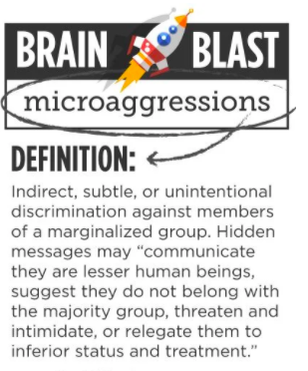

Slide 3
"The everyday slights, indignities, put downs and insults that people of color, women, 2SLGBTQ+ populations or those who are marginalized experiences in their day-to-day interactions with people."

Slide 4
Why is learning about microaggressions important?
Racial microaggressions are everyday insults or derogatory messages directed toward minorities and people of color, often from well-intentioned people who believe they’ve done nothing offensive.
Any minority group can experience microaggressions, which may be based on gender, race, ethnicity, nationality, religion, socioeconomic status, or disability.
While a microaggression may seem harmless, a lifetime of microaggressions can be quite devastating to a person’s mental and physical health.

Slide 5
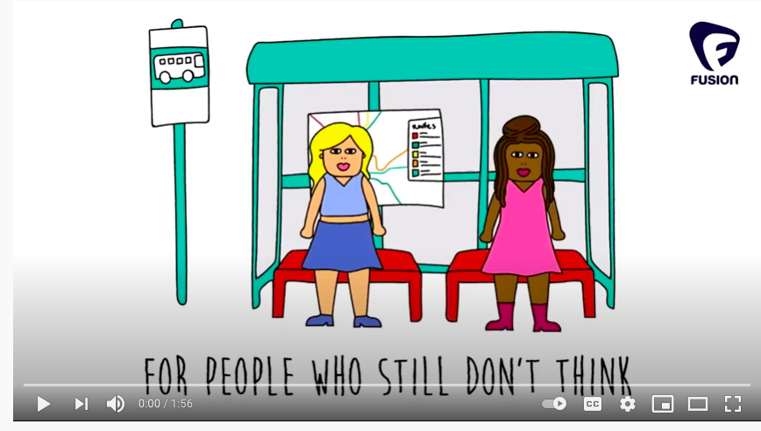
Breaking Prejudice: A metaphor to help explain microaggressions for people who still don’t think microaggressions are a problem
https://www.youtube.com/watch?v=nQ9l7y4UuxY&ab_channel=TheTeacherColeman

Slide 6
What does a microaggression look like?
An Asian-American student is complimented by a professor for speaking perfect English, but it's actually his first language.
A black man notices that a white woman flinches and clutches her bag as she sees him in the elevator she's about to enter, and is painfully reminded of racial stereotypes.
A woman speaks up in an important meeting, but she can barely get a word in without being interrupted by her male colleagues.

Slide 7
Implicit Bias and Microaggressions
Over the years, the concept has been extended beyond race to include similar events and experiences of other marginalized groups, including women, 2slgbtq+, people with disabilities, etc.
In schools, students report that experiences like these are fairly common:
“In high school, boys in my math classes would look over my shoulder and unsolicited point out my errors with their pencils.”
“Sometimes I’m asked, ‘Why are you so white?’ meaning that people with Arab names and heritage are supposed to be all dark-skinned, and I’m asked to justify my skin color and explain why I don’t match their racial stereotypes.”
Other microaggressions include teachers being surprised by certain students’ achievements or holding tests on religious holidays, and peers imitating foreign accents

Slide 8
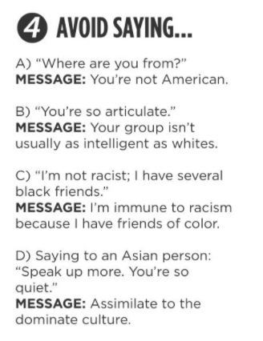
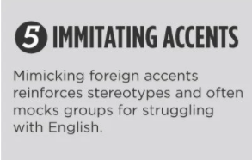
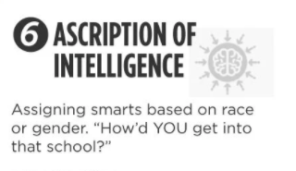
What types of microaggressions can we avoid?

Slide 9
What can we do?? Let’s Make A Change So Everyone Feels Safe at CPA !
#1 Start conversations about unlearning our biases and stereotypes we have been taught
#2 Avoid saying things with implicit assumptions based on stereotypes
#3 Stop assigning smarts based on race or gender
#4 Ask our teachers to help us educate ourselves on these topics and hold our education system accountable so we can condemn and unlearn racism
#5 Check our unconscious biases and work to educate ourselves on how we can become more inclusive and anti-racist

